Slide 1
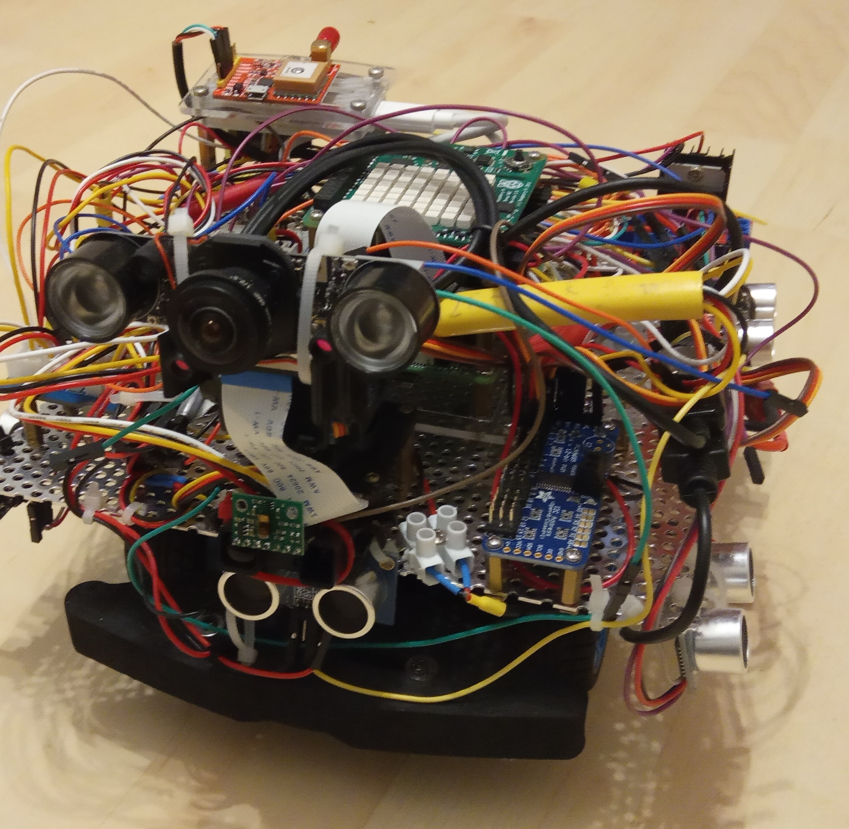
Roboterauto
Entwicklung von Fahrerassistenzsystemen, Algorithmen zum autonomen Fahren etc.

Slide 2
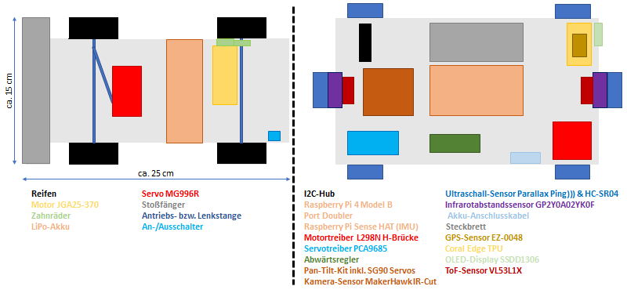
Aktorik und Sensorik

Slide 3
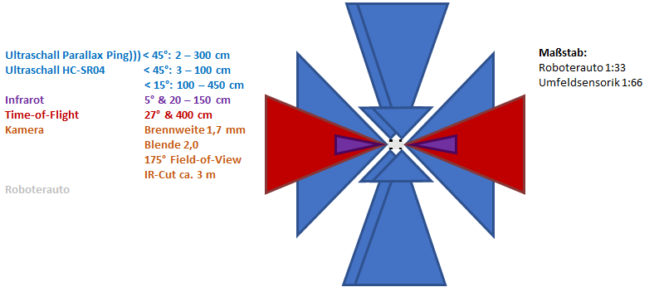
Maßstab Fahrzeugumfeldsensorik

Slide 4
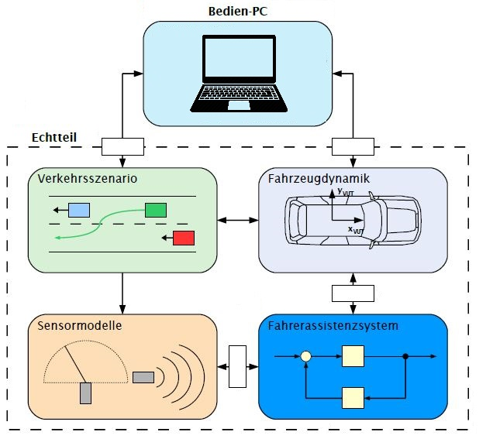
Simulationsmöglichkeiten

Slide 5
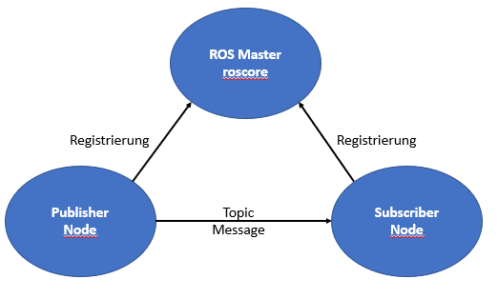
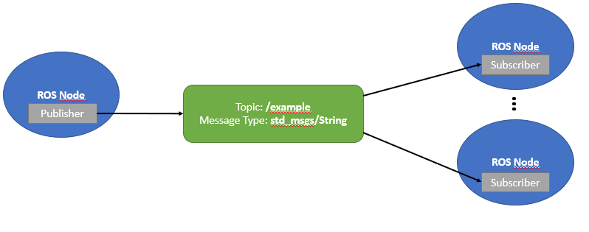
ROS Publisher-Subscriber als Datenkommunikation

Slide 6
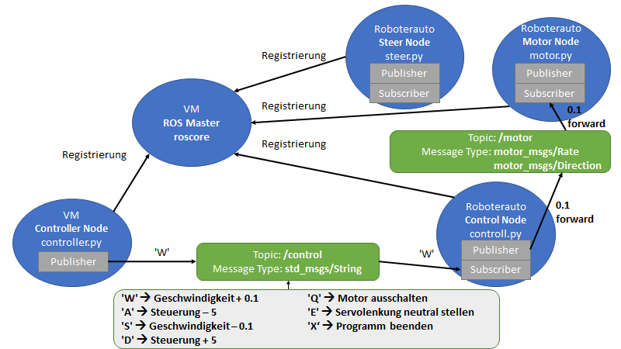
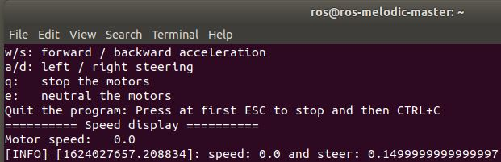
Steuerung

Slide 7
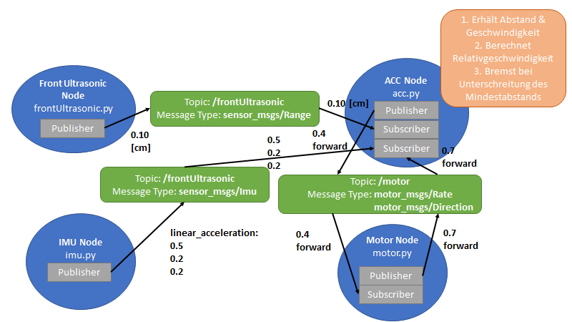
Beispiel: Fahrerassistenzsystem

Slide 8
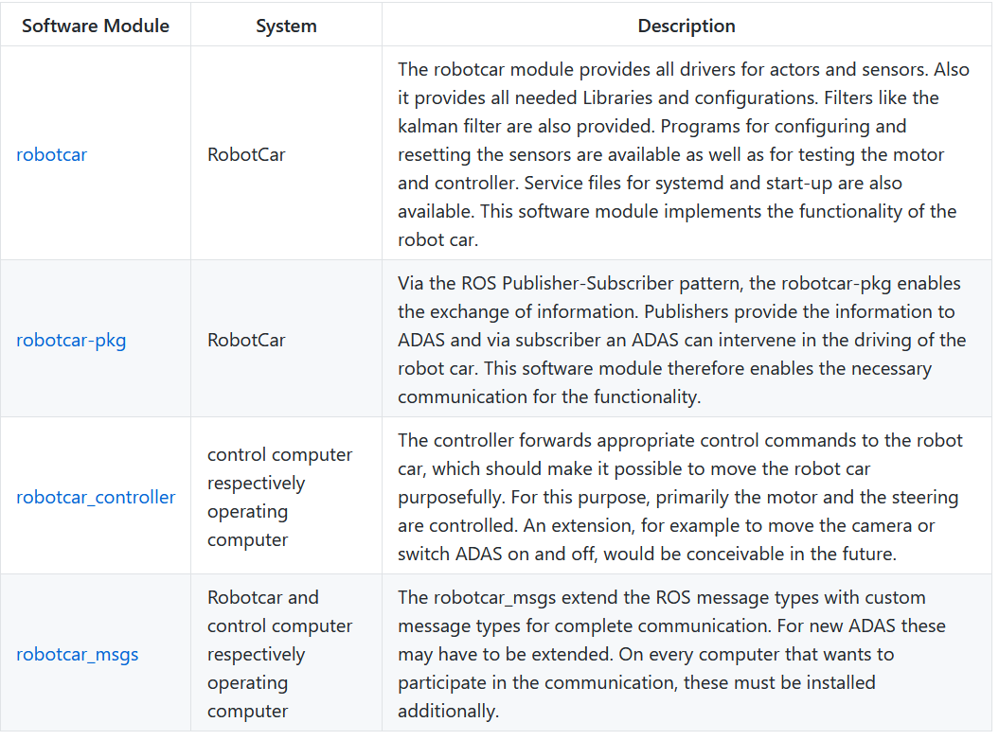

Slide 9
Further packages:
With the beginner_tutorials you can learn the basic concepts of the RobotCar.
With the robotcar_subscriber you can subscribe different informations from the RobotCar. It could be used as blue print for ADAS.
With the robotcar_sensorfusion_examples you can learn how to use as example a simple kalman filter for sensor fusion. It could be used as blue print for ADAS.
The std_header_msgs could be used as example for sensor fusion because the sensor fusion needs timestamps which are missing in the std_msgs from ROS.
The raspicam_node is needed to use the raspicam with ROS. So the robot car definitely needs this package.
The raspicam_node_saver is needed to save frames from the raspicam_node as individual JPEG frames or as avi video. It can therefore be used, for example, to record training data for machine learning.
The robotcar_plotter shows various curves for sensor information or diagrams for the position and orientation of the RobotCar, e.g. compass or 3D gyroscope, etc.

Slide 10
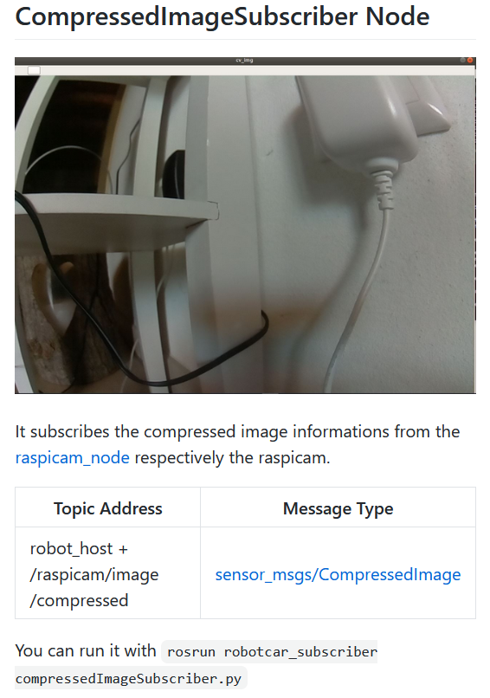
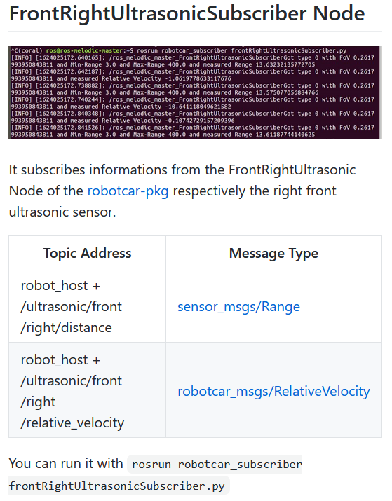

Slide 11
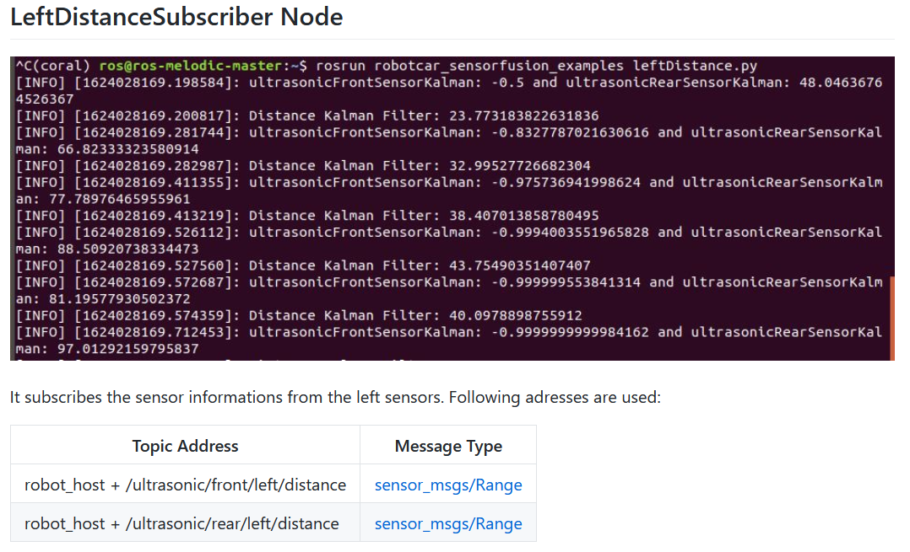
Beispiel: Sensorfusion mit Kalman-Filter

Slide 12
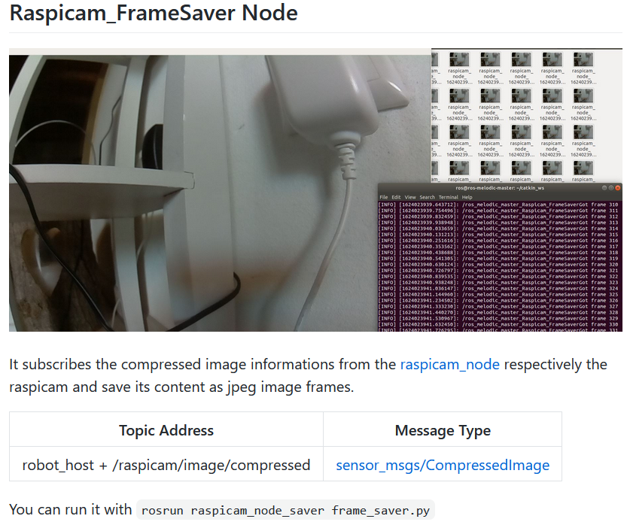

Slide 13
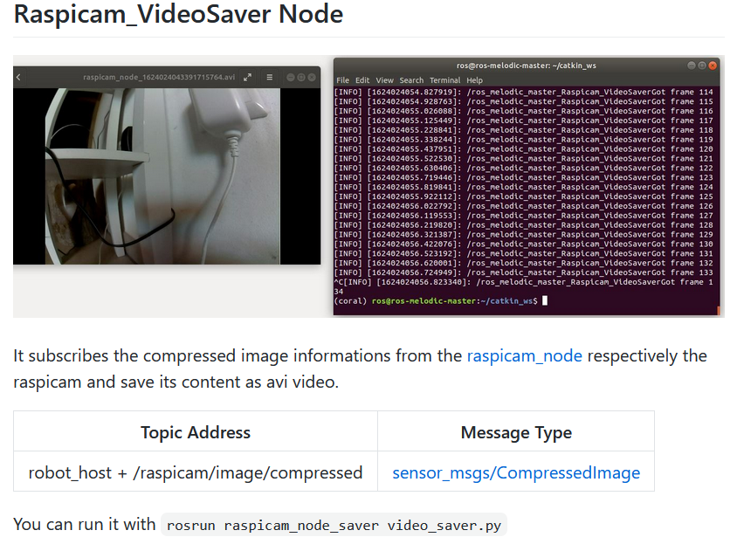

Slide 14
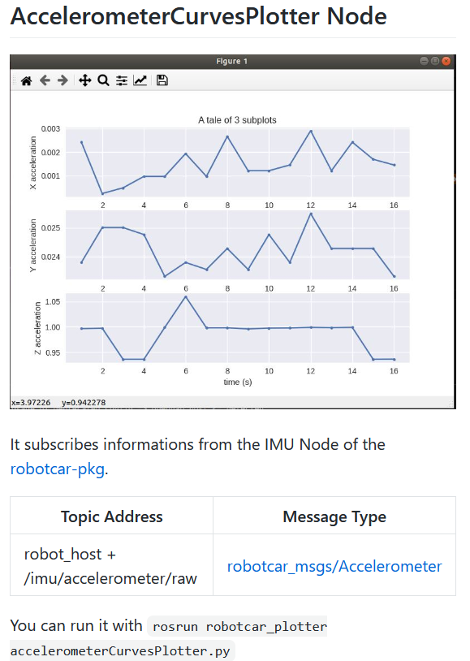
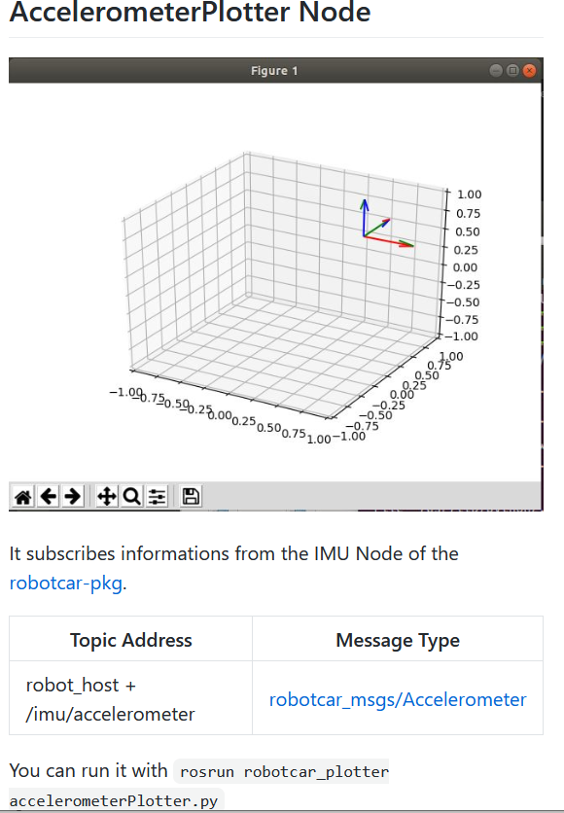

Slide 15
